Slide 1
Valuing Homes in Ames, IA
Michael Hayden

Slide 2
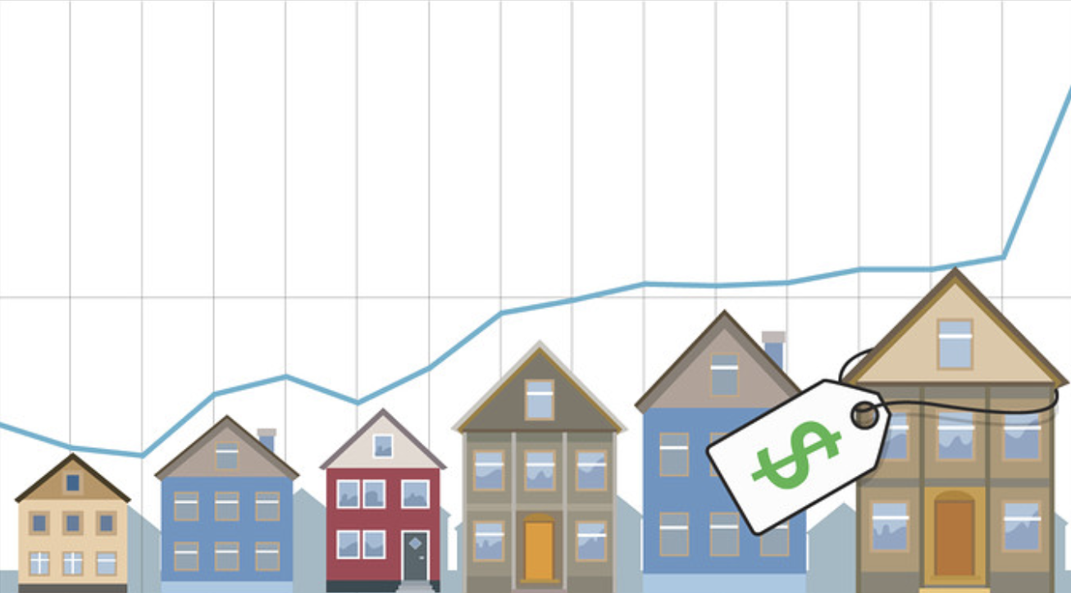
Predicting Home Prices with a Model
Do you ever wonder if the next home you are looking at purchasing is fairly priced?
Do you want to see how your house compares to other homes in the area?
If you answered “yes” to either of these questions, the following slides might present some valuable information. This information uses data from the Ames Iowa homes sold from 2006-2010

Slide 3
The Ames, IA Data Set
The project used a data set provided by the city of Ames, Iowa.
The set included roughly 3,000 separate instances over a 4-year time span.
Each home included roughly 80 variables with it.
After cleaning the data set to ensure the information was in the correct format (without errors or missing values), I was able to make sure every value was accounted for and dummy variables were used in the case of categorical values.

Slide 4
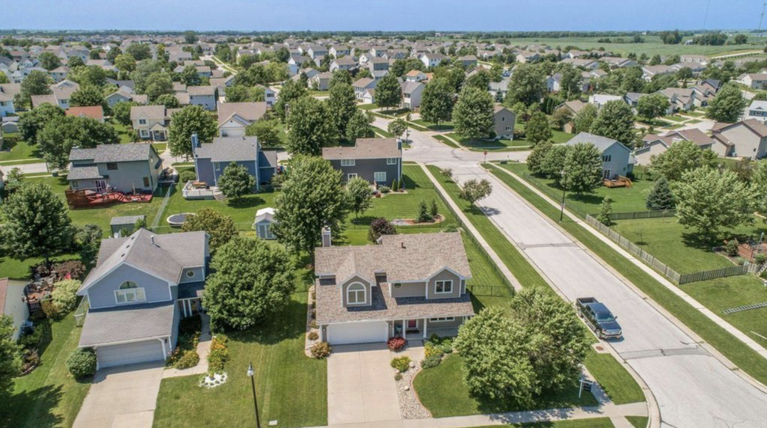
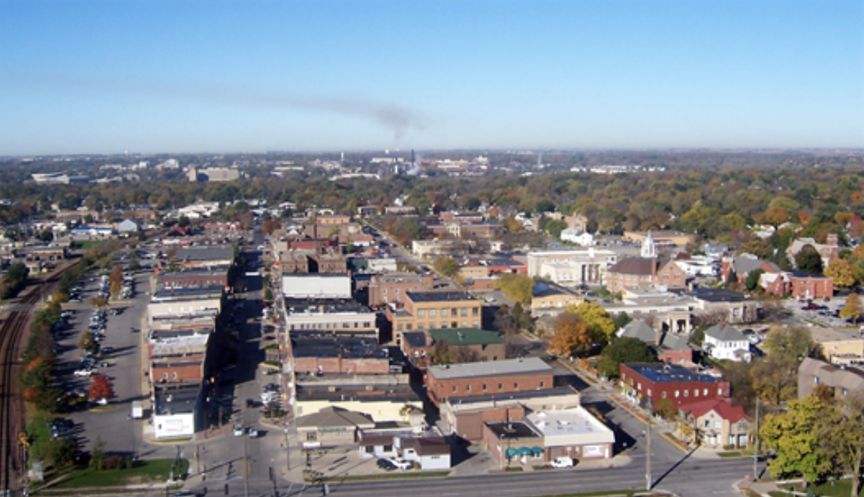
Ames Iowa Facts
2,930 homes sold in Ames, IA between 2006 and 2010
Average home size 2,250 ft^2
Most expensive home sold $755,000
Average age of homes sold fall at 36 years old
Average remodel age of home is 23 years old

Slide 5
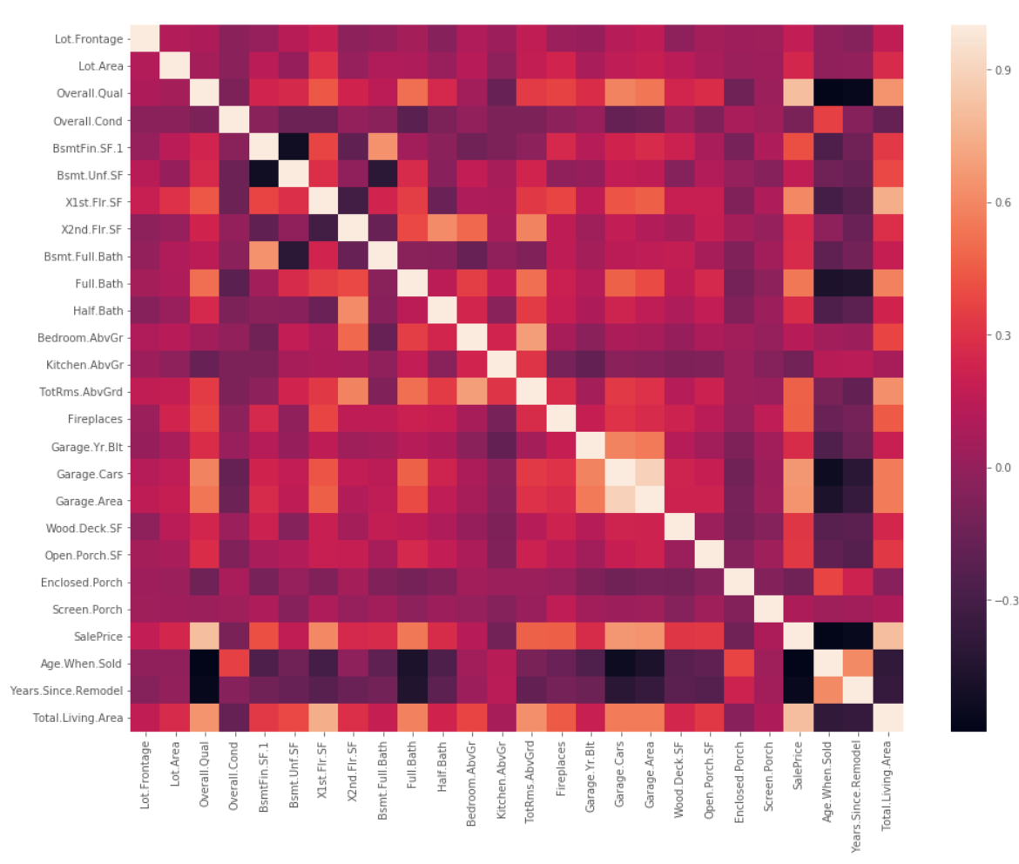
Locating the Important Factors
The heat map to the right highlights how much of a correlation can be found between different variables in the data.
The downward trending white line shows a perfect correlation when comparing a value to itself.
Squares that are closer to black and white are more relevant to the project
This map offers great insight into the key factors in determining a fair priced, quality home.

Slide 6
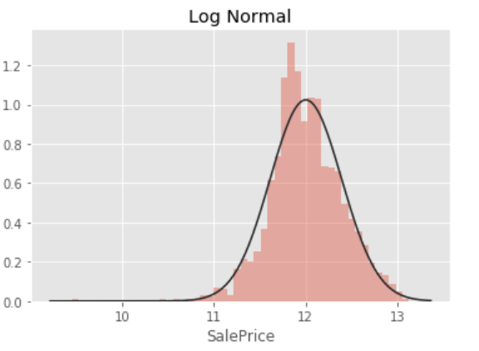
What was the Skew?
Before the skew was transformed we had a 1.16 skew which does not fall within acceptable standards
The high skew came from the large variance of values within the data set

Slide 7
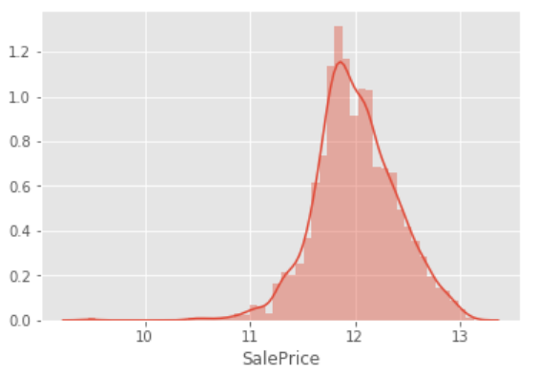
What the Skew Became
After normalizing the skew we achieved a skew of .214 which will allow us to move forward to the model

Slide 8
What was our test RMSE?
The test RMSE was .051 based on an 70-30 split test
We are close to the residual line

Slide 9
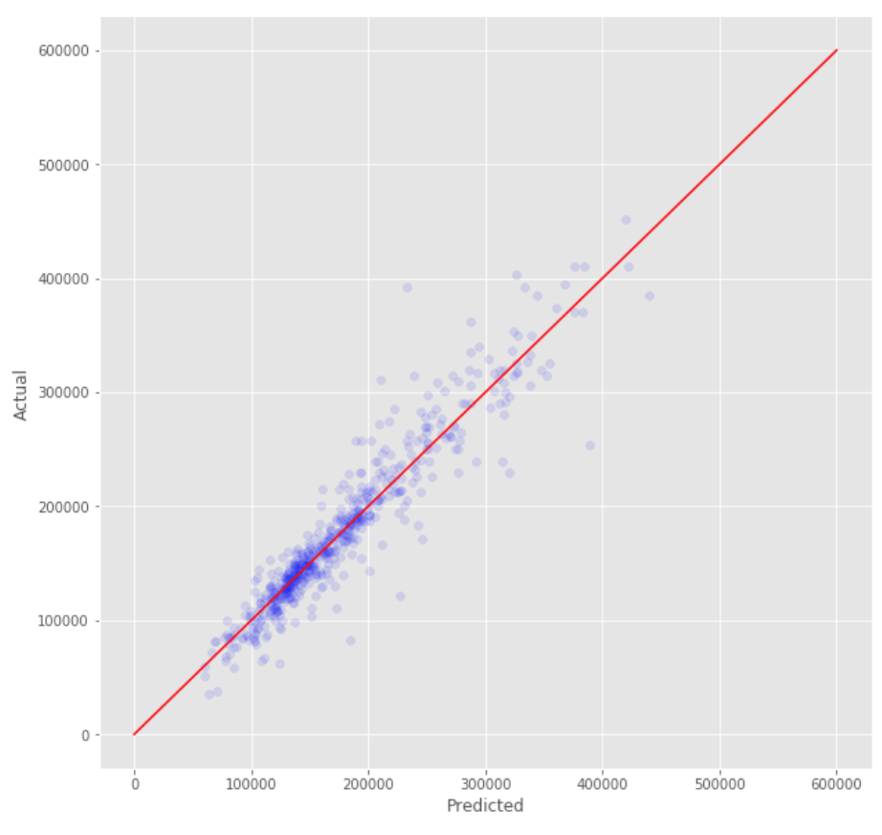
What did the test score?
X axis is Predicted Value
Y axis is Actual Value
A perfect model would produce a 45 degree line where the model would perfectly predict the price of the home
The model scored .902 which shows the model is running well

Slide 10
Take Away
After building this project, we were able to find out which factors drive the value of a home
Features that drive value of a home include size, quality, garage size, and number of bathrooms
Features that don’t matter as much include screened porches, basement bathrooms and location of the kitchen
Knowing which factors can contribute to either selling a home or purchasing a home can be very useful in making sure you are receiving the best value.

